Slide 1
FLASH CARDS PROJECT
Developed By FenyX IT Academy

Slide 2
Team Members
Ahsen Bucak
Elif Sahin
Fatih Demir
Mehmet Nazliay
M.Kemal Basbudak

Slide 3
Timeline Style
Step 1
Step
2
Step
3
Step
4
Step
5
Step
6
Step
7
Step
8
UML Design
UI Design
Codes
.EXE and .DMC
Created a Use Case Diagram and Class Case Diagram
Designed a user friendly interfaces with Pqt5 tools.
Developed clear codes using Python and OOP
Concept.
Converted Python files to .EXE and .DMC folder.
Github
Data Parsing
Implementation
Tests
Detailed a folder according to the UML design and pushed it Github.
Cleared unstructured data
to use and store.
Checked whether application works and maintained.
Distributed .EXE and .DMC files to users and collected feedbacks.

Slide 4
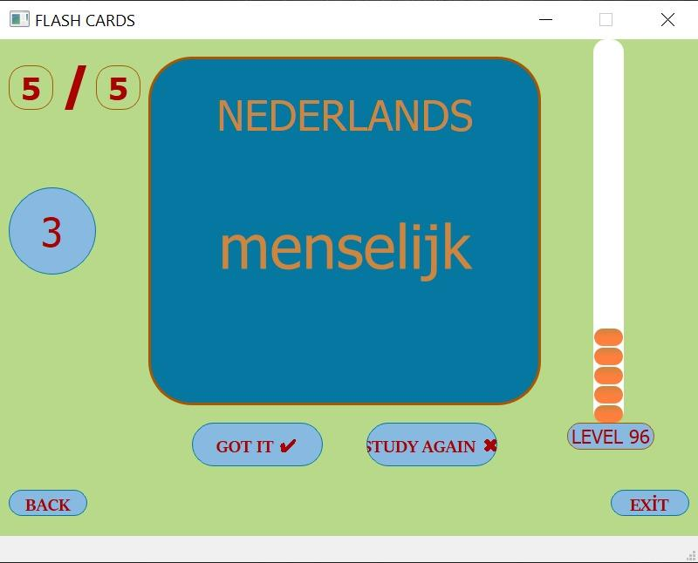
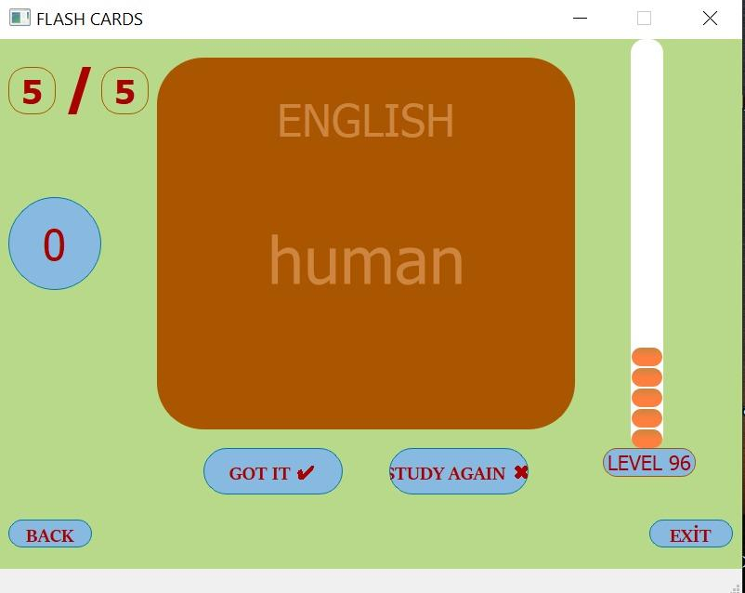
Short Review to App

Slide 5






Tools We Used
Trello
Qt Designer
Python
Lucidcharts
Github
You can simplyimpress your audience and add a unique zing and appeal to your Presentations.
OUR TOOLS WE USED
Place Your Picture Here
You can simply impress your audience and add a unique zing and appeal to your Presentations.

Slide 6
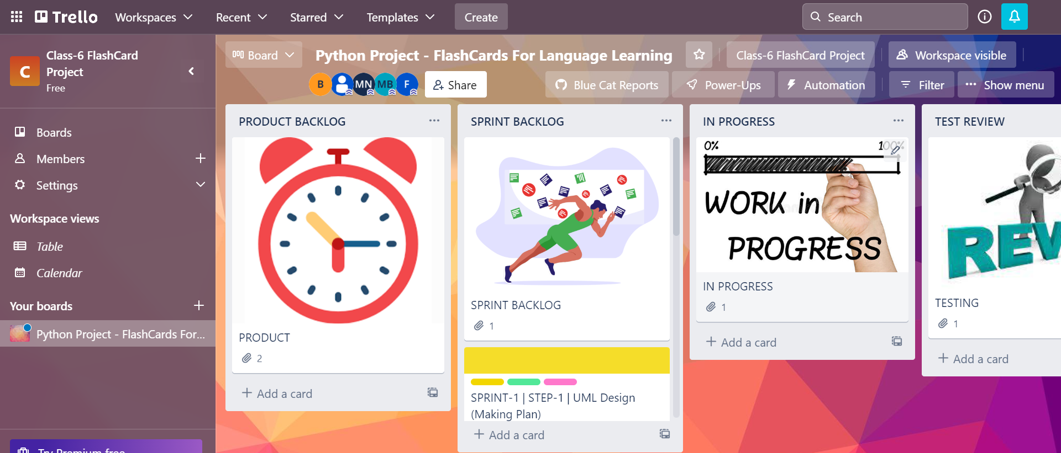
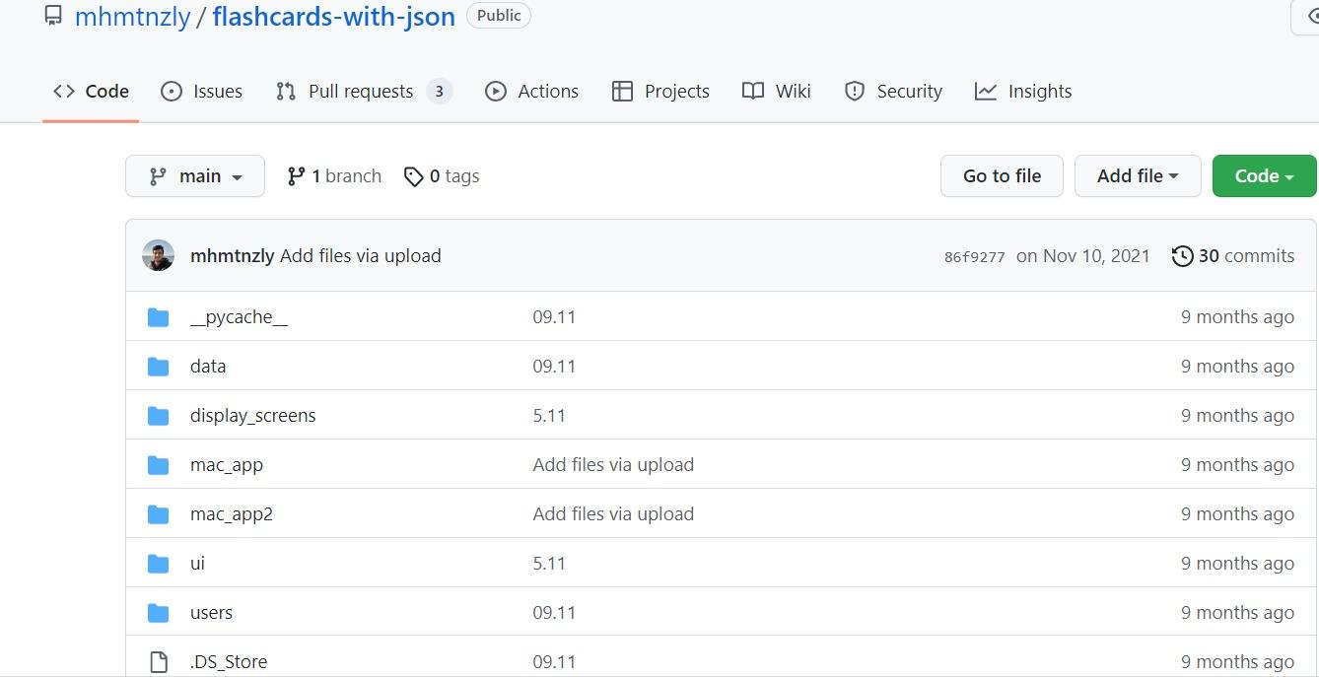
Trello
Github

Slide 7
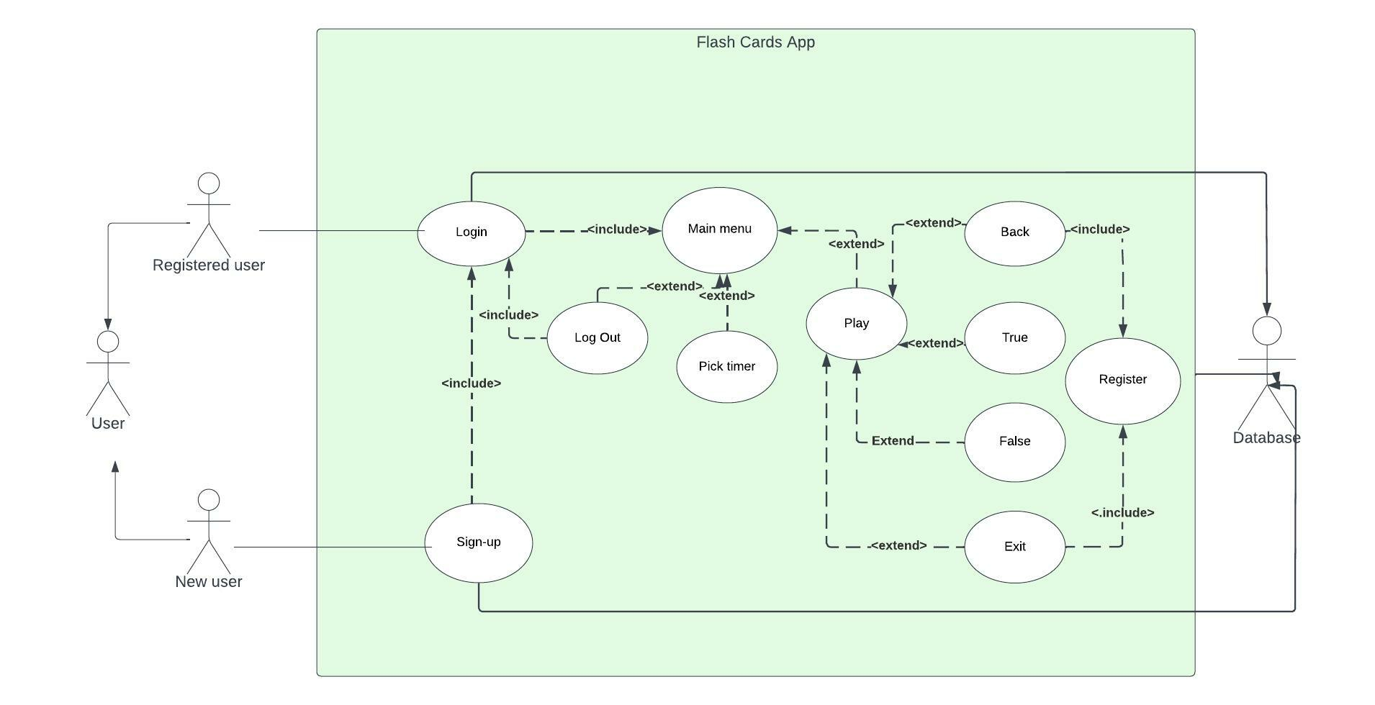
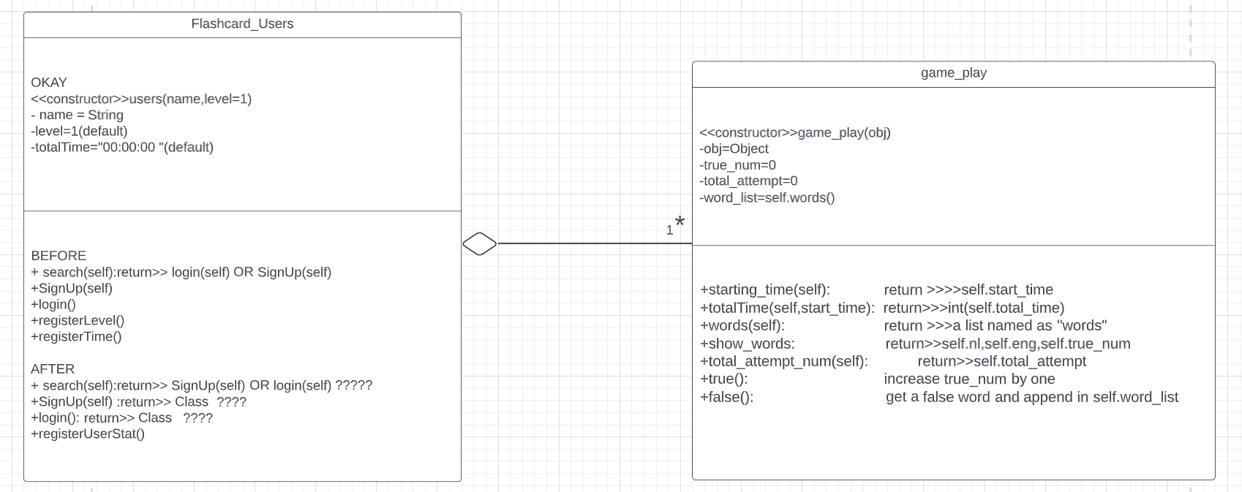
Use Case Diagram
Class Diagram

Slide 8
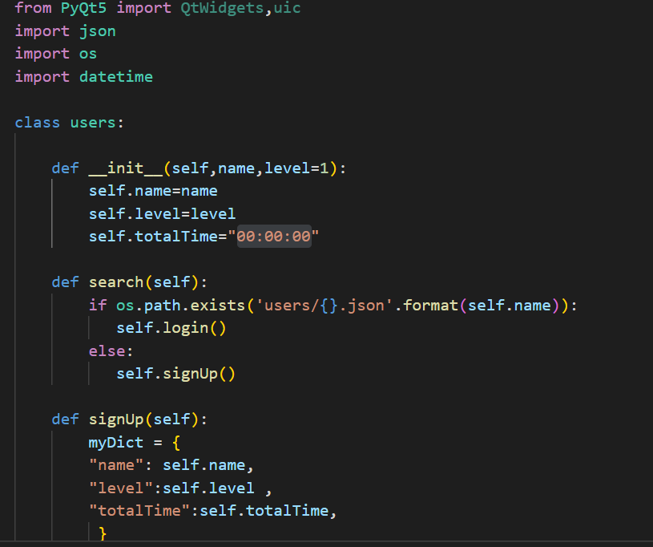
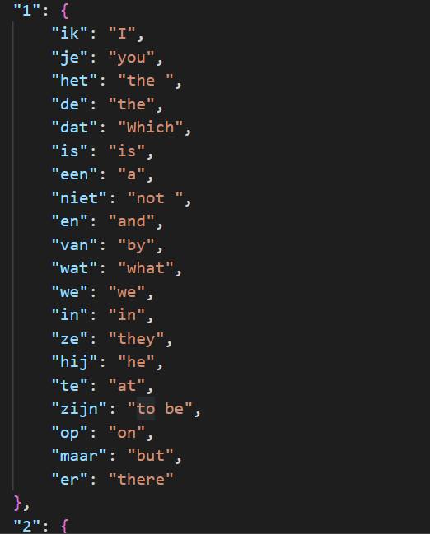
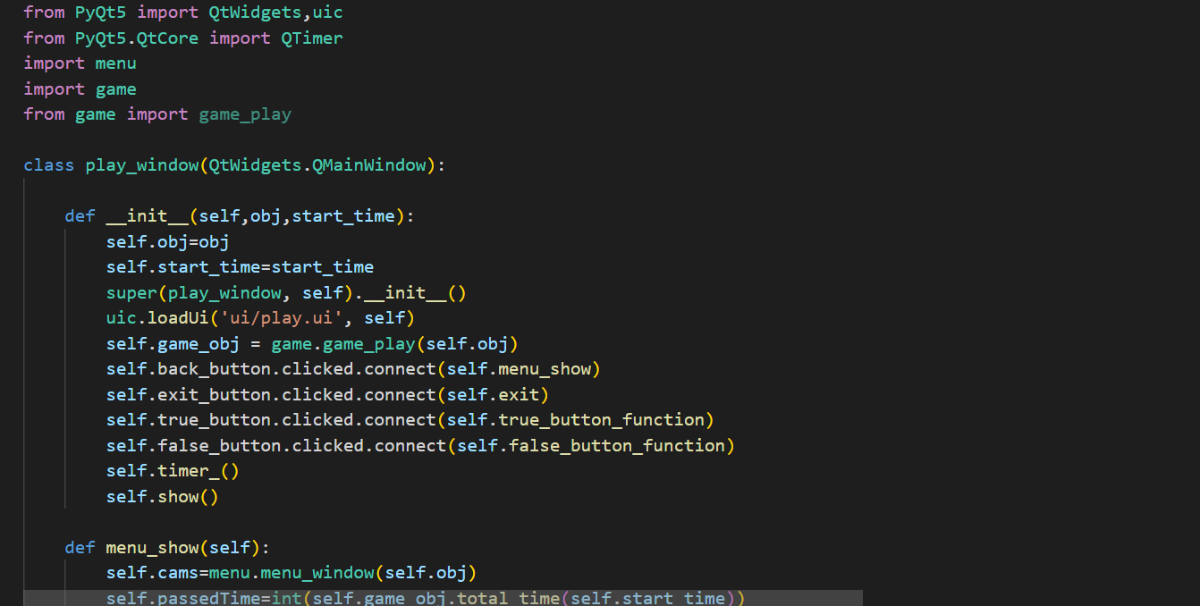

Slide 9
Implementation

Slide 10
THANK YOU

